Slide 1
CSE 471 - Lab 04
Class Diagram

Slide 2

Class Diagram

Slide 3
SuperMART
SUPERMART buys snack products from local producers through contracts. At most 2 producers can be involved in a contract, each with a different percentage of sharing the profit. One producer can have multiple contracts for different products. The store has both in-house and on-demand food-safety inspectors to ensure product quality. Each inspector can be in charge of multiple products.
Find the classes, relations, label for each relation, multiplicity for the above scenario.

Slide 4
SuperMART
SUPERMART buys snack products from local producers through contracts. At most 2 producers can be involved in a contract, each with a different percentage of sharing the profit. One producer can have multiple contracts for different products. The store has both in-house and on-demand food-safety inspectors to ensure product quality. Each inspector can be in charge of multiple products.
Find the classes, relations, label for each relation, multiplicity for the above scenario.

Slide 5
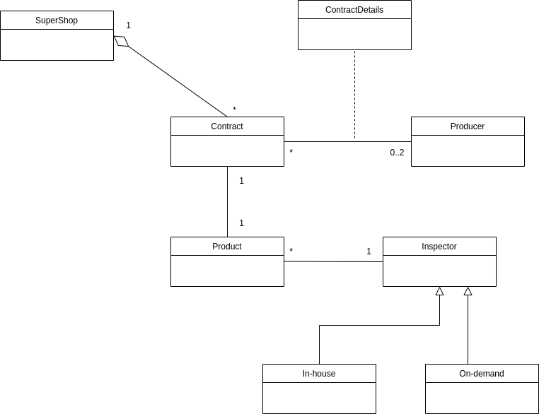

Slide 6
Golla-Tournament
A Gollachooooot tournament has at least 10 extraordinary GOLLA teams. Each golla-team consists of 10-15 players. Oh, each team also has a golla-captain. Every player wears a scary golla-jersey and plays at a certain position. Each team has a unique golla-name and record. Like every other sport, teams are guided by coaches. Coachees need to have certain years of experience and seniority level to lead teams in the tournament. Since coaches and players are humans after all, need to track their names and addresses. Throughout the tournament, the teams play against each other. For every game, the location for the game and score is recorded.

Slide 7
Golla-Tournament
A Gollachooooot tournament has at least 10 extraordinary GOLLA teams. Each golla-team consists of 10-15 players. Oh, each team also has a golla-captain. Every player wears a scary golla-jersey and plays at a certain position. Each team has a unique golla-name and record. Like every other sport, teams are guided by coaches. Coachees need to have certain years of experience and seniority level to lead teams in the tournament. Since coaches and players are people after all, need to track their names and addresses. Throughout the tournament, the teams play against each other. For every game, the location for the game and score is recorded.

Slide 8
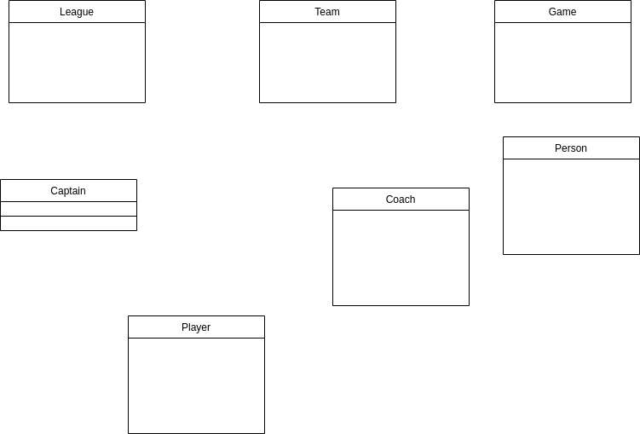

Slide 9
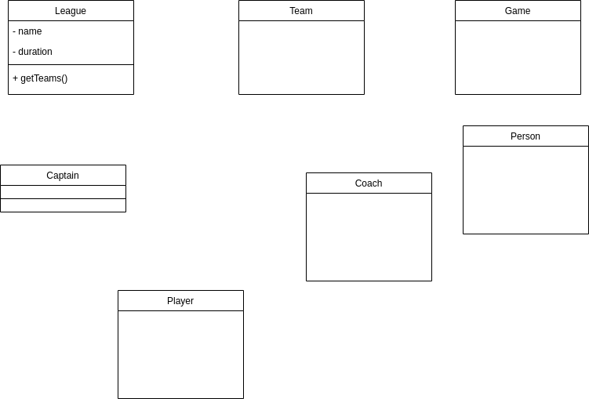

Slide 10
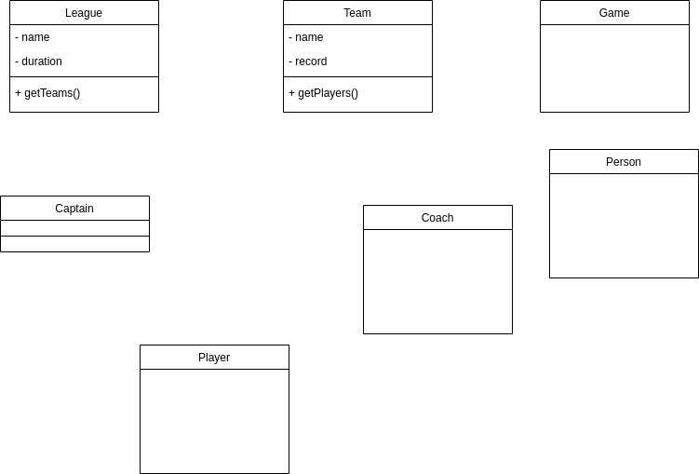

Slide 11
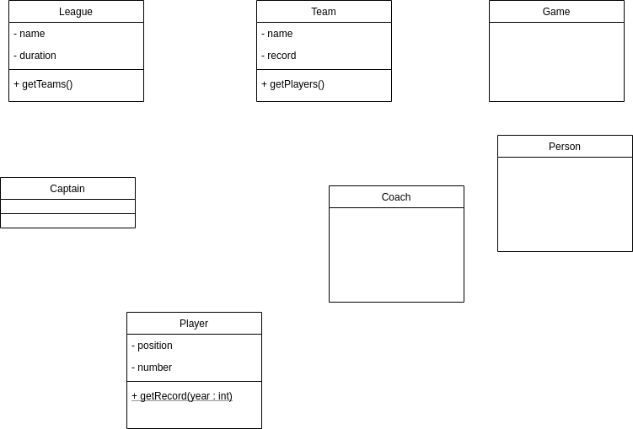

Slide 12
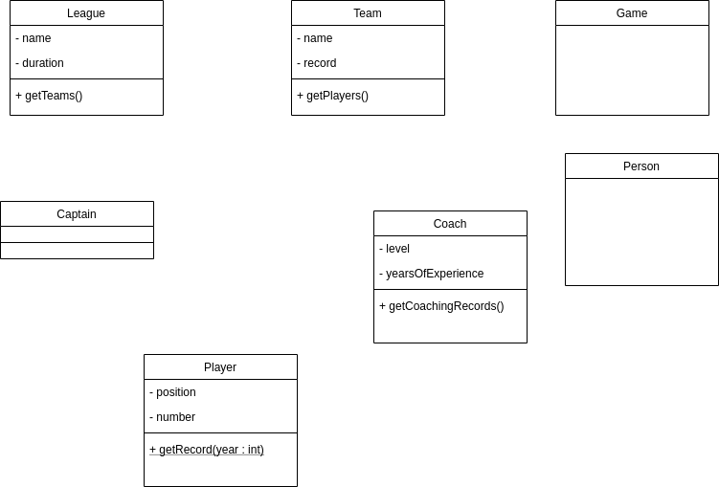

Slide 13
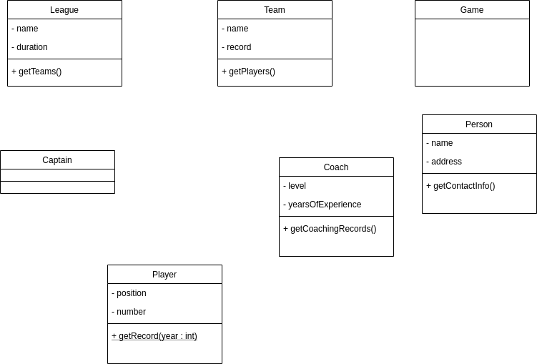

Slide 14
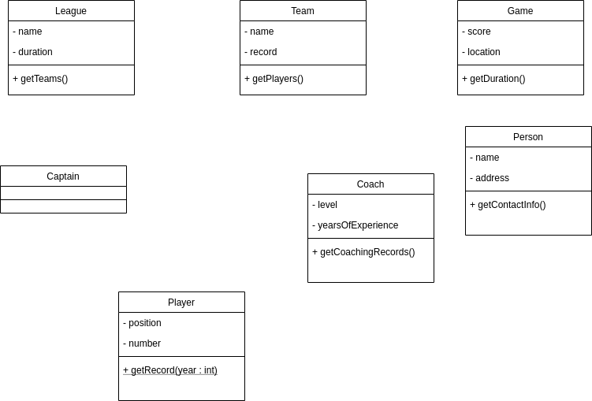

Slide 15
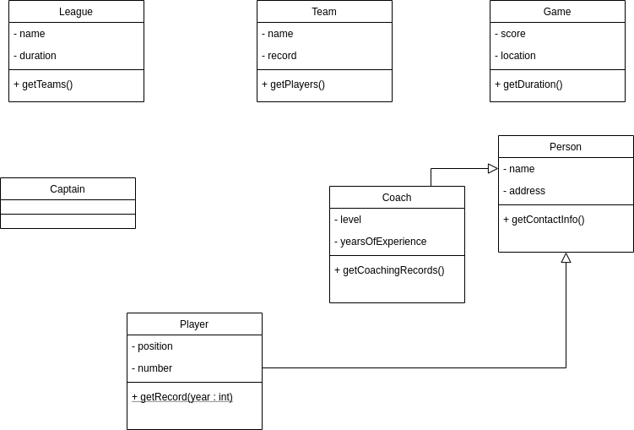

Slide 16
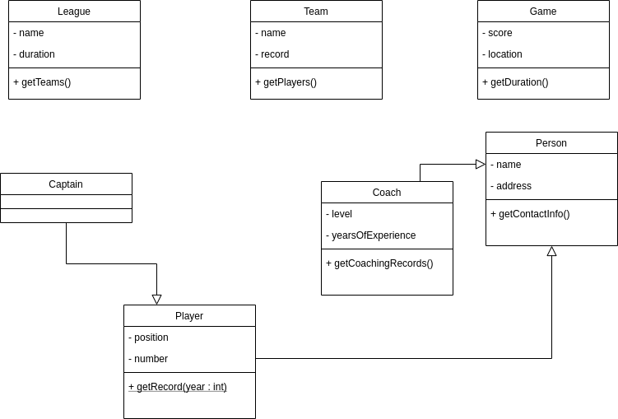

Slide 17
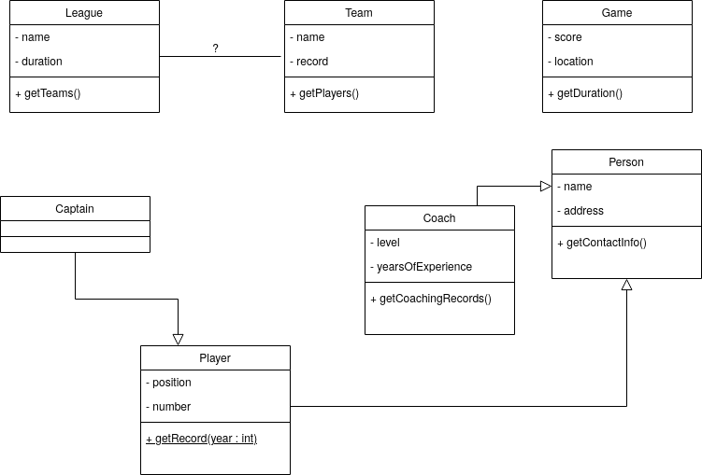

Slide 18
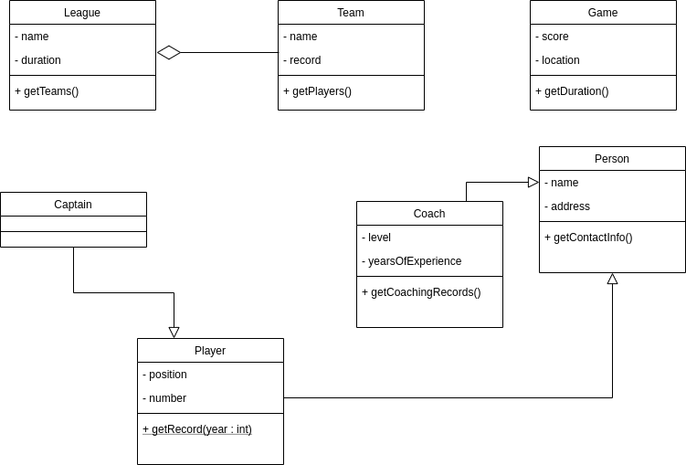

Slide 19


Slide 20
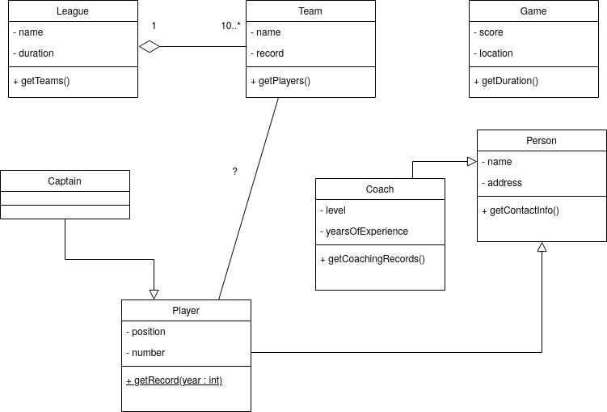

Slide 21
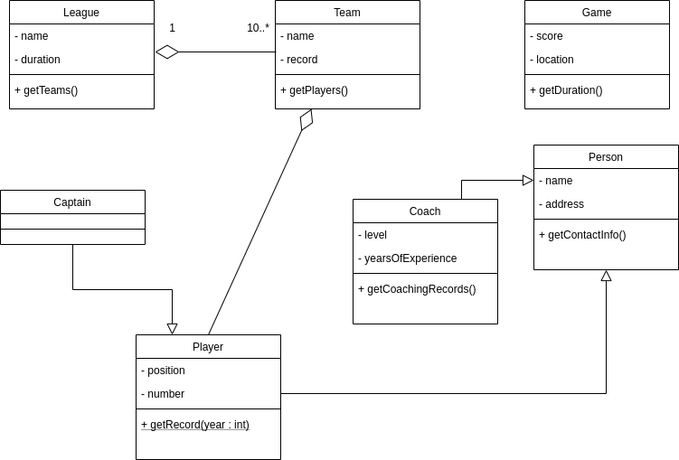

Slide 22


Slide 23
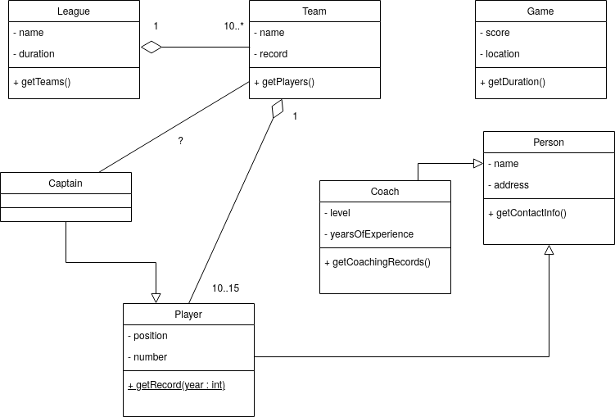

Slide 24
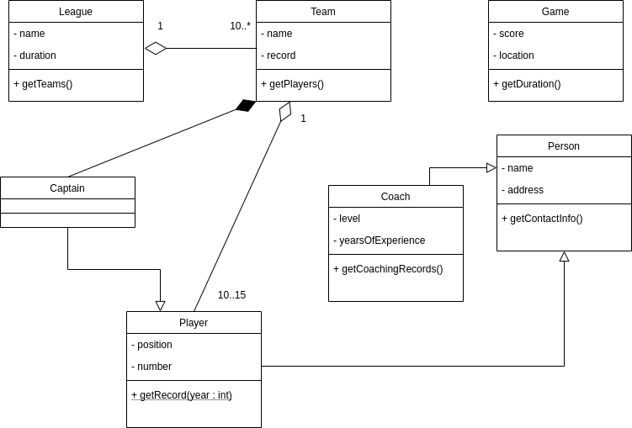

Slide 25


Slide 26
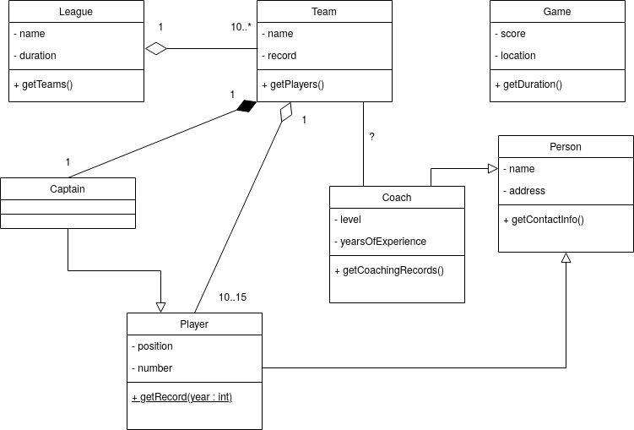

Slide 27
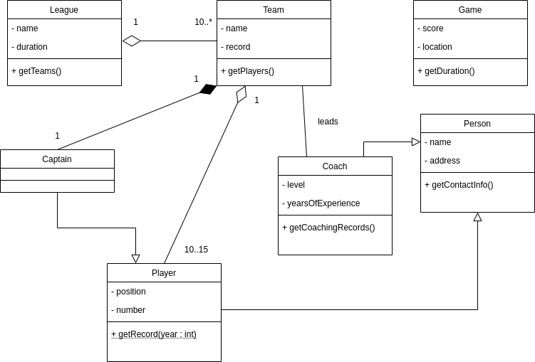

Slide 28


Slide 29
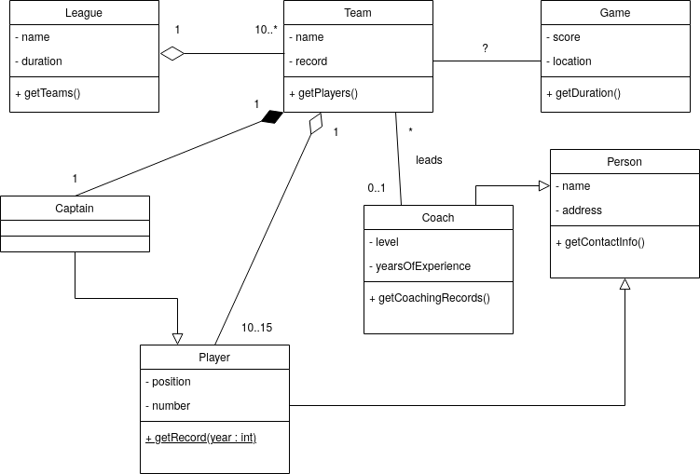

Slide 30
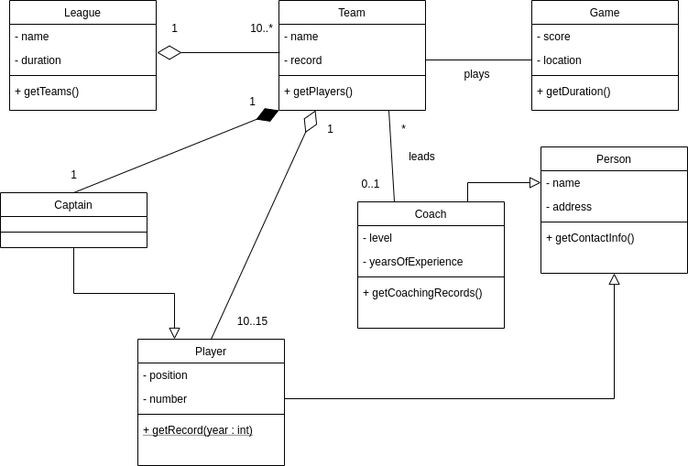

Slide 31


